Slide 1
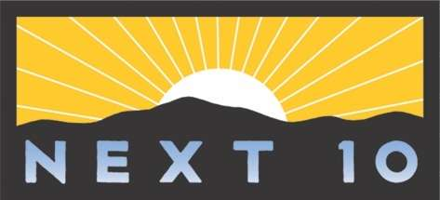

Slide 2
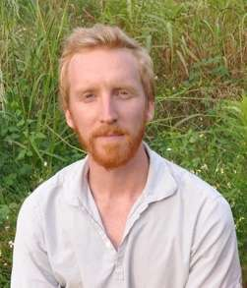
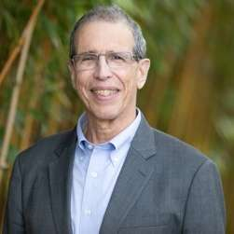
Today’s Talk
Zachary Lamb
Assistant Professor of City and Regional Planning
UC Berkeley
Rob Olshansky
Visiting Professor
UC Berkeley

Slide 3
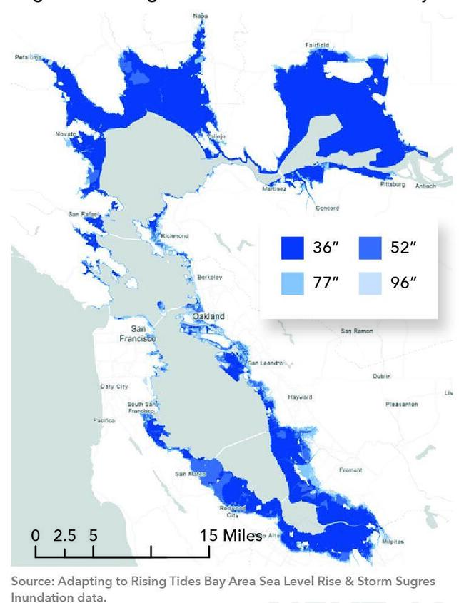
Sea Level Rise and the Bay
Projected Sea Level Rise in the Bay Area
Sea level rise poses a significant threat to Bay Area communities needing an estimated $110 billion to protect them by 2050.
Recent studies reveal the extent and costs of public infrastructure for adaptation to SLR.
Adaptation will also occur through thousands of decisions by those who own and control threatened property, but current land governance systems cannot easily manage environmental change.
Notes:
Sea level rise poses a significant threat to Bay Area communities, and would need an estimated $110 billion to protect them by 2050.
To put that in context, California spent $1.2 billion on wildfires in 2020-2021 due to the severe fires that year.
We wanted to get ahead of the problem and fill the gaps in existing research about how we can adapt to the rising seas in a more collective, purposeful way, rather than in a more fragmented, piecemeal fashion.

Slide 4
Three Challenges
The report introduces a framework for enabling transformative adaptation, outlining three necessary shifts, from:
Static to flexible property regimes;
Fragmented to collective action;
Deeply unjust property relations to forms of land governance and property that advance justice.
We then propose strategies to rethink current fragmented and static property systems around the Bay and beyond.

Slide 5
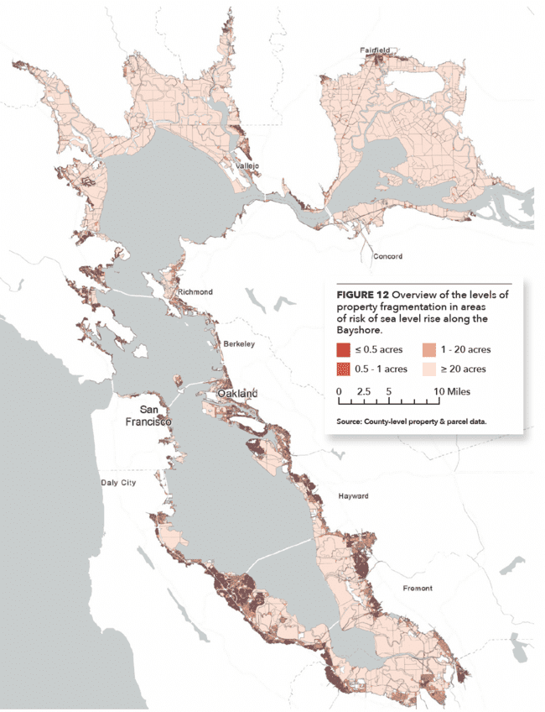
Property and Adaptation
Rigid, fragmented, and unjust property regimes make adapting to sea level rise (SLR) difficult, costly, and inequitable.
Fragmented property divisions impede area-wide adaptation, from wetland restoration or levees to managed retreat.
Static parcel boundaries mean that a relatively small number of landowners bear the burden.
Conventional responses, such as house-by-house buyouts and insurance are unjust, disproportionately benefit already empowered groups and leaving others behind.

Slide 6
Transformative Property Strategies

Slide 7
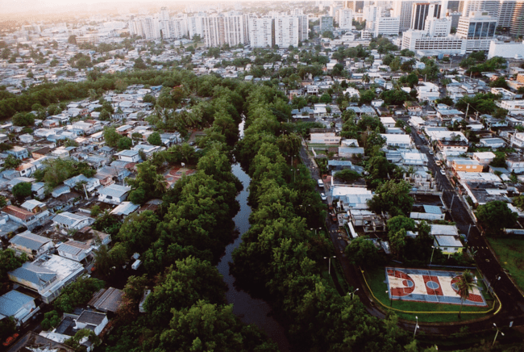
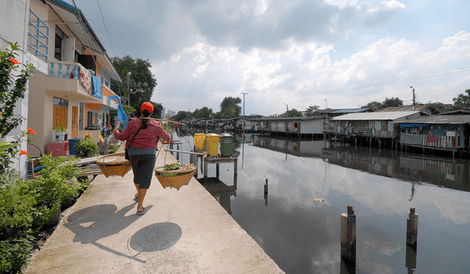
Many Useful Strategies Exist
El Cano Martin Pena, San Juan, Puerto Rico
Baan Mankong, Bangkok, Thailand
Cities and countries around the world have successfully applied strategies to equitably manage environmental change. Many of these proven models may be well-suited to California.

Slide 8
Transformative Property Strategies
Strategy Types | Examples
Moving Property Rights | Rolling Easements
Managing Multiple Parcels | Land Trusts
Collective Ownership | Homeowners Associations
Split Tenure Housing | Mobile Home Parks
Public Financing | GHADs
Redressing Historic Property Injustices | Land-Based Reparations

Slide 9
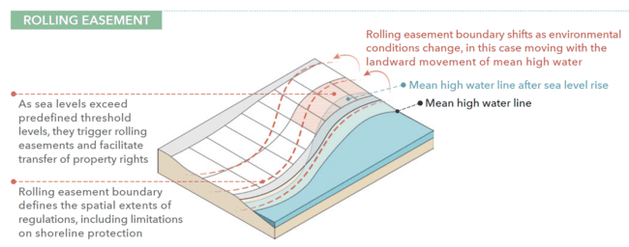
Tools for Moving Property Rights

Slide 10
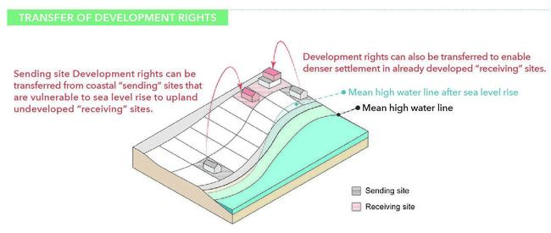
Tools for Moving Property Rights

Slide 11
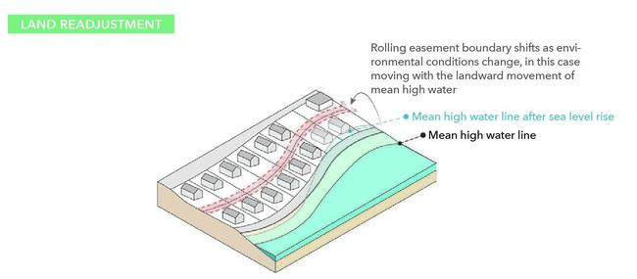
Tools for Moving Property Rights

Slide 12
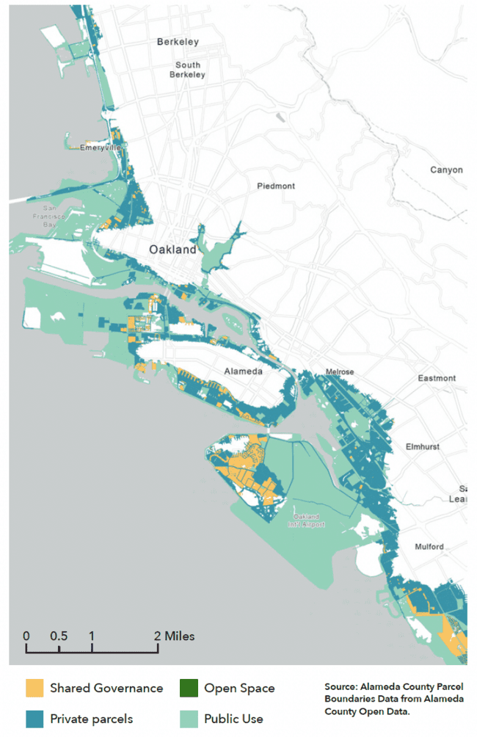
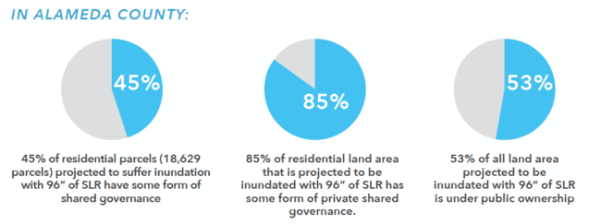
Tools for Collective Land Ownership
Fragmented and individualized property models are dominant, but they are not universal. Current systems already incorporate a variety of forms of shared ownership.

Slide 13
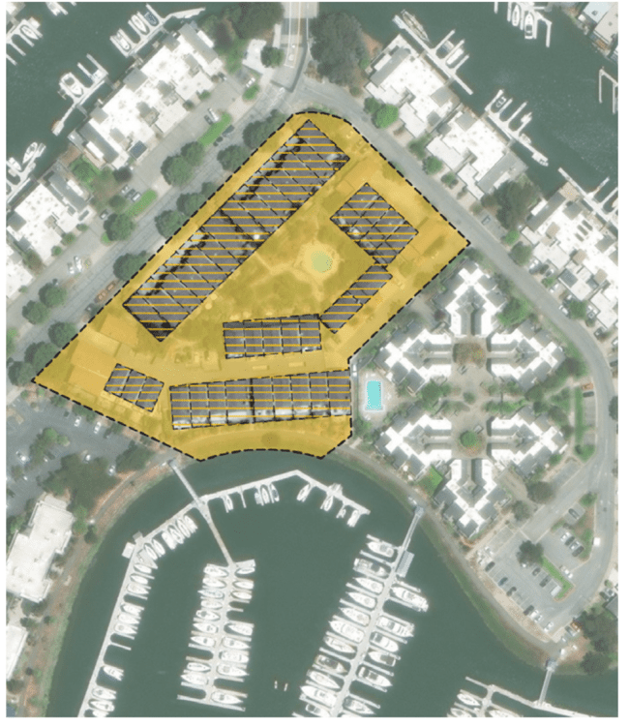
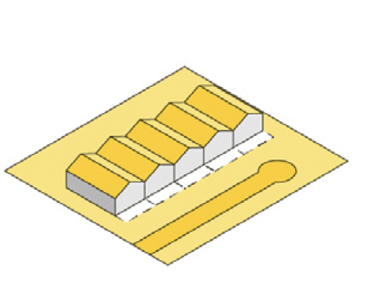
Collective Ownership - Condominium
Condo owners own the space inside individual units and share ownership of walls, floors, and common areas such as hallways, stairs, and outdoor areas.
Condominiums that achieve consensus can collectively decide on mitigation, adaptation, or relocation actions, including using common open spaces to facilitate relocation of vulnerable homes.
Example: Ballena Bay, Alameda

Slide 14
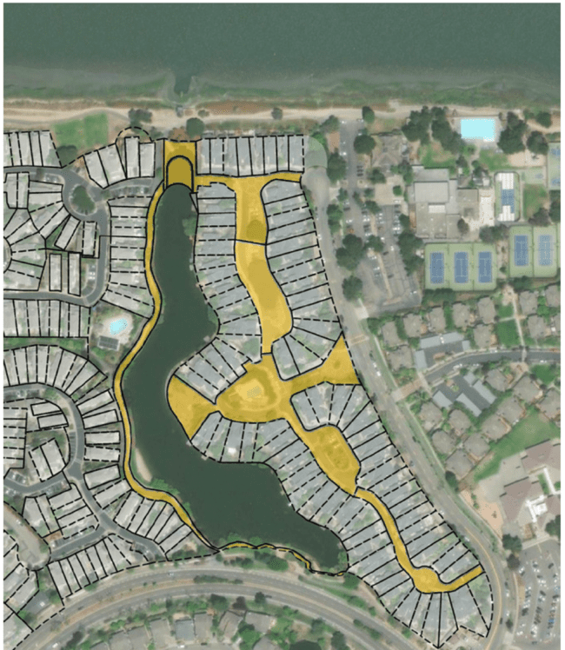
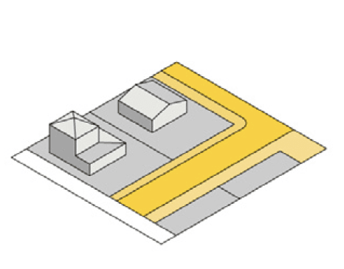
Collective Ownership: HOA’s
Homeowners associations (HOAs) became a very common form of residential development beginning in the mid-20th century. They often focus on property value preservation and aesthetic conformity.
HOAs own and enforce rules for shared spaces within residential communities, including roadways, open space.
HOAs will shape adaptation decision making for millions of households in the years to come.
Example: Bay Farm Island, Alameda

Slide 15
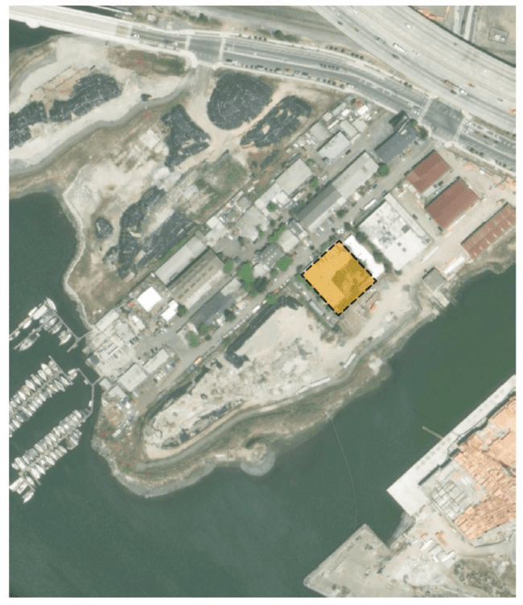
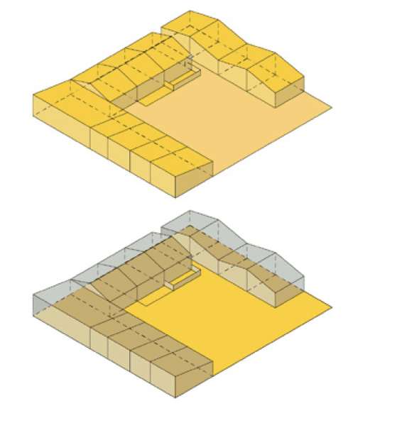
Managing Multiple Parcels – Land Trust
Land trusts are legal entities that acquire and hold property rights for a wide range of purposes, from wildlife conservation to neighborhood stabilization.
Land trusts can facilitate climate adaptation in several ways, including:
Preserving undeveloped land along shorelines,
Holding land for green infrastructure projects,
Acquiring and holding rolling easements,
Managing sending and receiving sites,
Providing affordable housing.
Example: Shade Tree, Oakland

Slide 16
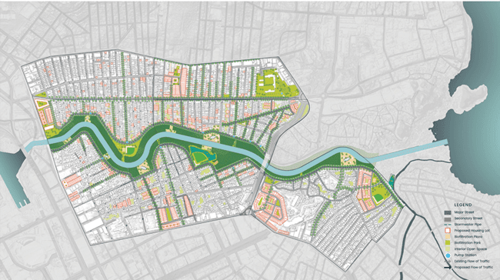
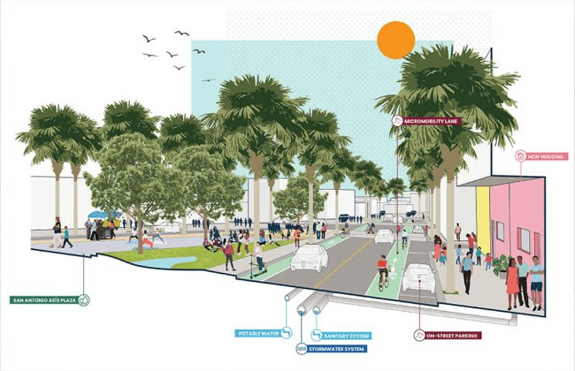
Collective Ownership - CLT
Community Land Trusts are non-profit organizations that own land for the benefit of their community, most commonly to provide affordable housing. While CLTs own the land, residents can purchase or rent housing units.
CLTs can enable voluntary relocation of property rights, including from coastal to upland land owned by the CLT.
Example: Fideicomiso de la Tierra, El Caño Martín Peña, San Juan, PR

Slide 17
Scenarios & Case Studies

Slide 18
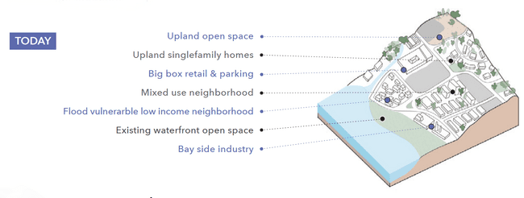
Present Day Overview
Dominant property regimes are static, fragmented, socially regressive.
Notes:
One way that we explored the role of property and land governance in shaping adaptation to SLR on the bay was through scenarios. We invented a little slice of urbanized bayfront that includes:

Slide 19
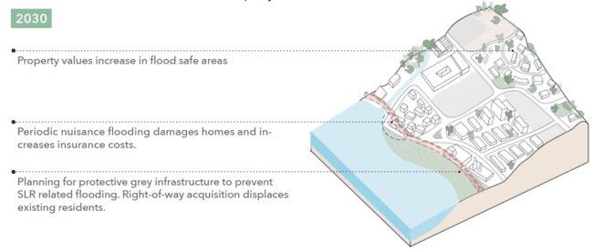
Scenario A: Conventional Property
In this scenario, property regimes remain predominantly static, individualized, and socially regressive
Notes:
We then walked through one version of a likely future under current property regimes… dominated by static, fragmented, and socially regressive land governance.

Slide 20
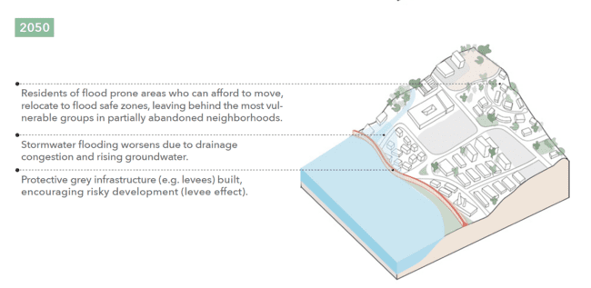
Scenario A: Conventional Property

Slide 21
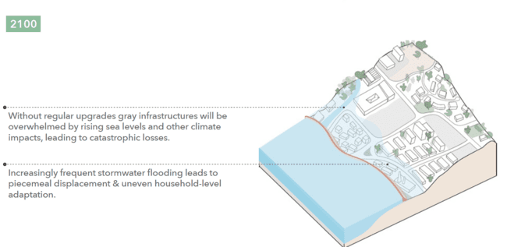
Scenario A: Conventional Property

Slide 22
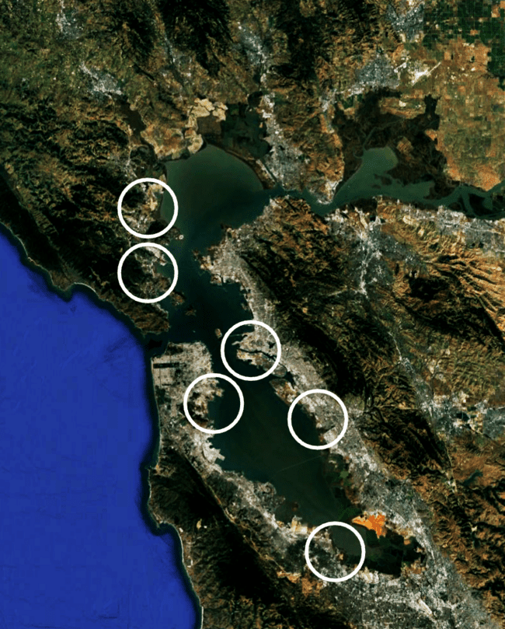
Case Studies
Six Case Studies
UC Berkeley, Urban Design Studio
Spring 2023
Each Group
Analyzed site conditions; and
Developed a suite of adaptation proposals that included both physical and institutional innovations centering transformative approaches to property.
Notes:
Given this unacceptable ‘BUSINESS AS USUAL’ scenario, we worked with a group of masters of city planning students at UC Berkeley to imagine alternatives…
The groups worked on 6 different SLR vulnerable sites around the bay… analyzing current and projected future conditions and then developing a suite of adaptation proposals that included both physical and institutional innovations, centering transformative approaches to property.

Slide 23
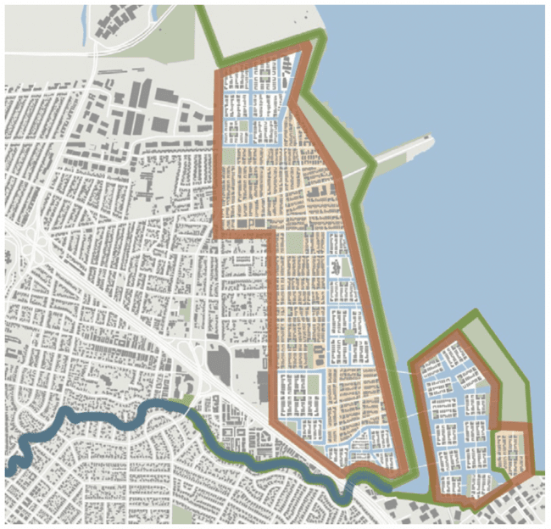
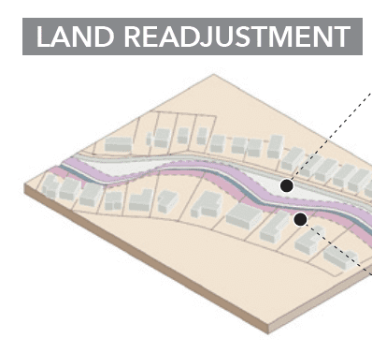
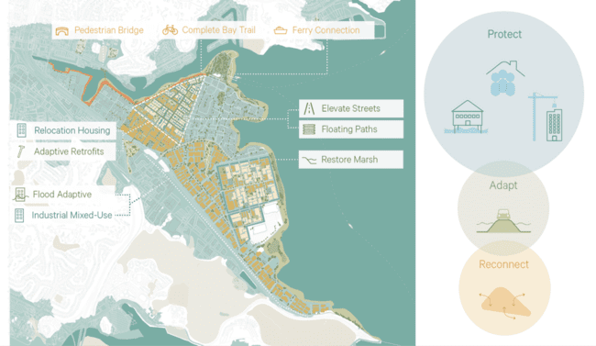
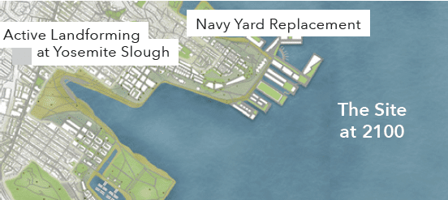
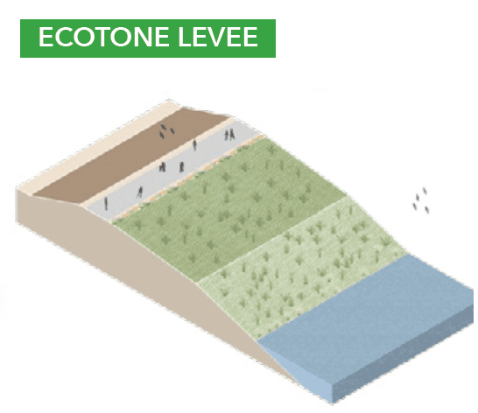
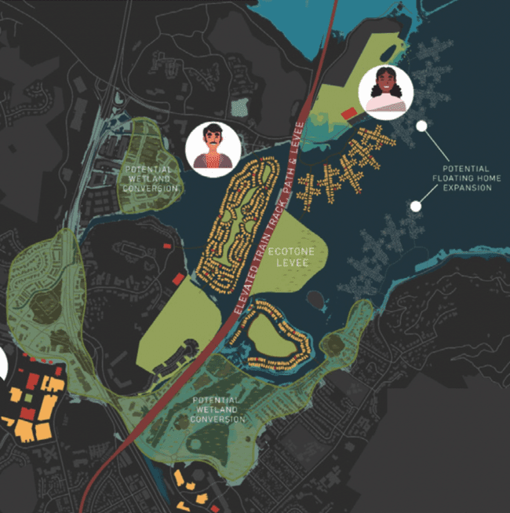
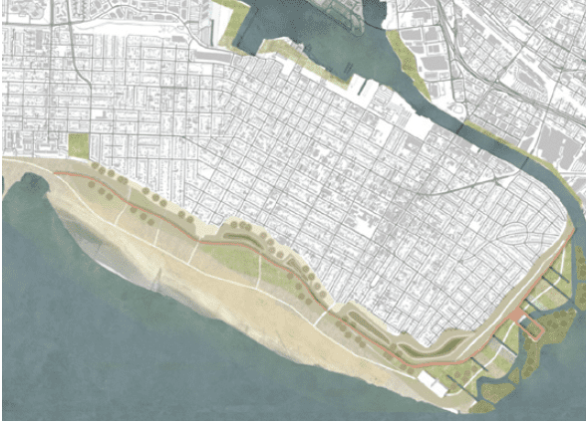
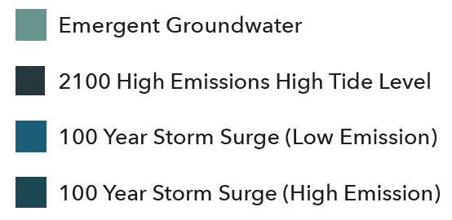
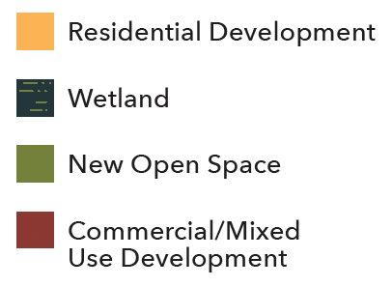
Case Studies
East Palo Alto
Hunters Point, SF
Canal District, San Rafael
San Leandro/San Lorenzo
Gallinas
Oakland/Alameda
Notes:
In each of these cases, the teams sought to generate institutional and physical adaptation strategies that would reduce SLR vulnerability while also addressing the underlying causes of uneven vulnerability to flooding in each site.
For instance: the group that worked in San Rafael’s Canal District focused on integrating anti-displacement measures to insure that residents of this neighborhood (which includes a high proportion of low income immigrant households) would not be displaced in the process of reducing the area’s flood vulnerability.
The group that worked in Oakland and Alameda proposed using rolling easements to encourage gradual resettlement of households from the especially vulnerable southeastern corner of Alameda to new flood adaptive neighborhoods on the Naval Air Station site.
And the group that worked on the San Leandro / San Lorenzo waterfront proposed strategies for linking flood adaptation with reparations for the displacement of residents from the once thriving Black community of Russell City in the mid-20th century.

Slide 24
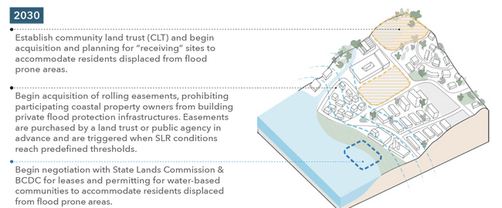
Scenario B: Adaptive Property
In this scenario, alternative property regimes
enable new forms of adaptation that are more
cost effective and equitable
Notes:
After this work with the Studio, we developed another scenario for our invented slice of the Bay… this time incorporating transformative property strategies.
In this case, a CLT is established to purchase flood safe land that will eventually house relocated communities from threatened shoreline communities.
A rolling easement program prohibits coastal residents from building protective infrastructure and enables the acquisition of vulnerable land once a pre-established flood level has been reached.
We also imagine that local communities could negotiate with the BCDC and State Lands Commission to gain access to bayfront areas to build new water adaptive settlements… ONLY IN AREAS where both shoreline ecology and existing infrastructure and settlement patterns support such a move.

Slide 25
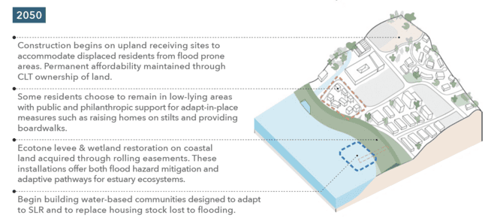
Scenario B: Adaptive Property
Notes:
By 2050 - we imagine:
Construction begins on upland receiving sites to accommodate displaced residents from flooded bayside areas. The CLT ownership in these areas would secure their permanent affordability and guard against future gentrification.
Those who choose to live in flood exposed areas could receive support to adapt to a new way of life that accommodates periodic flooding.
Ecotone levees and wetland restoration along the shoreline could mitigate storm flooding and enable the migration of estuary ecosystems.
And our imagined water-based community would begin taking shape.

Slide 26
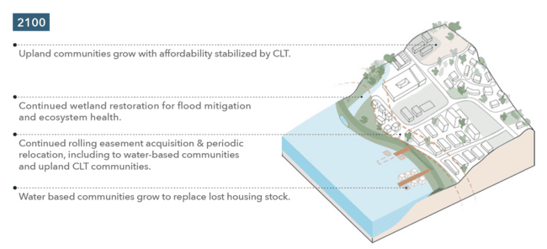
Scenario B: Adaptive Property
Notes:
Finally, by 2100:
We imagine that the upland CLT community would begin taking shape.
Wetland restoration along the shoreline would continue.
Rolling easement acquisition and relocation would continue, including enabling people to move to new water-based communities and/or upland CLT zones.

Slide 27
Conclusion & Policy Recommendations

Slide 28
Summary
Rigid, fragmented, and unjust property regimes make SLR adaptation difficult, costly, and inequitable. Conventional tools compound these problems.
Many proven property and land governance strategies already exist – internationally and in California – to equitably manage environmental change.
Based on case studies of Bay Shore communities, we have shown how alternative property regimes can enable new forms of adaptation that are more cost-effective and equitable.
Now is the time to develop, test, and implement strategies to enable and promote transformative adaptation.

Slide 29
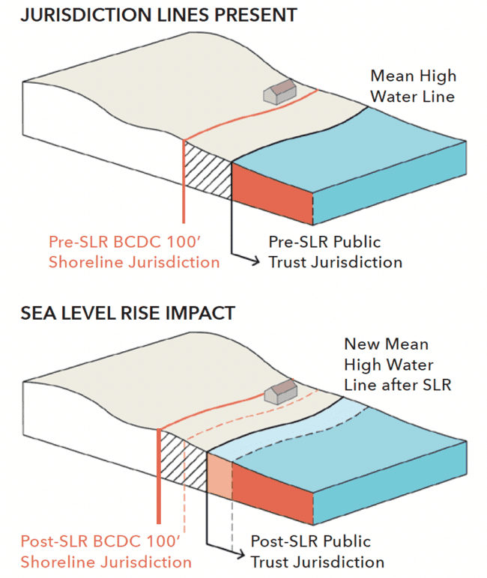
Policy Recommendations
Enable the Bay Conservation & Development Commissions (BCDC) to become a vehicle for transformative adaptation:
Much of BCDC’s 100-foot shoreline band of jurisdiction will be inundated, becoming public property.
Thus, BCDC’s mandate and jurisdiction will need legislative modification.
Support adaptation on shared ownership lands:
Much of the land subject to SLR is owned by various types of private common-interest communities (e.g., HOAs and condo boards).
They could use commonly held lands for adaptation with broad benefits, but only if they have the right incentives and resources in place.

Slide 30
Policy Recommendations
Improve coordination between public, private, and shared ownership entities:
Collective investments in green infrastructure and adaptive strategies will need multiple levels of cooperation.
Existing regional entities–public, private, and nonprofit–could convene collaborative councils to coordinate collective investments.
State agencies could support such efforts.
Explore a broader range of property strategies:
Alternative property rights strategies would make it easier to move property rights from one location to another and intentionally share the costs of sea-level rise.
A potential starting point would be to create a regional or statewide task force to evaluate such strategies, explore financing options, test feasibility in pilot communities, and identify legislative or policy changes needed to support them.

Slide 31
Looking Ahead
Adopting transformative property strategies would:
Ease the process of adaptation (including relocation of homes and businesses, investments in infrastructure, and ecological restoration);
Create collective governance structures that could continue to adapt over time; and
Support just transformations, such as returning Indigenous lands.
If we begin now to apply the creative talents of the Bay Area to this challenge, we can create new mechanisms to support successful adaptations for the rest of this century and beyond.

Slide 32
Thank you for your participation View the full report at next10.org/bayshore-urbanism Emails: zlamb@berkeley.edu robo@berkeley.edu
Q&A

